Slide 1
Arduino with GSM Module

Slide 2
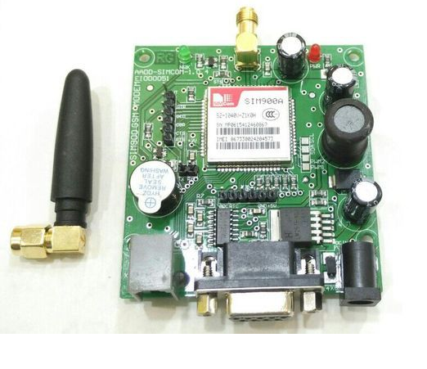
SIM900A
TX/ RX
Gnd

Slide 3
Operations Supported
The SIM900 is a complete Quad-band (850/900/1800/1900MHz) GSM/GPRS solution
Voice, SMS, Data

Slide 4
Connections
GSM Tx –> Arduino Rx
GSM Rx –> Arduino Tx.
Make the ground common between Arduino and GSM modem.

Slide 5
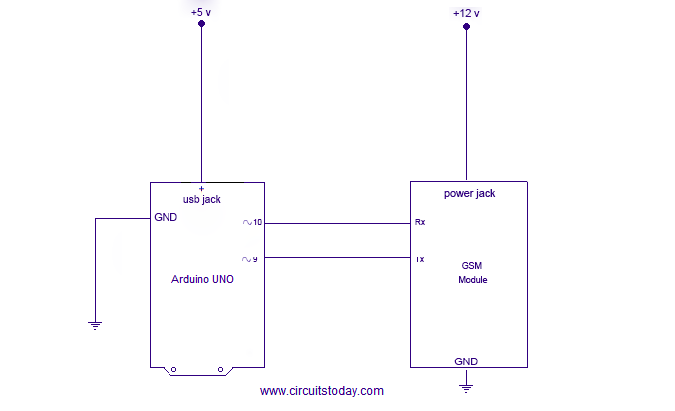
Connections ……..

Slide 6
Steps
Insert SIM in allocated slot
Power on GSM modem with 12V power supply
Check the status LED, It should blink once in 3 seconds
Call to the number, you should get callback tone

Slide 7
AT Commands used
TO MAKE A VOICE CALL:
ATD9876543210;
TO REDIAL LAST NO:
ATDL
TO RECEIVE INCOMING CALL:
ATA
TO HANGUP OR DISCONNECT A CALL:
ATH
TO CHECK THE MODEM:
AT
OK
TO CHANGE SMS SENDING MODE:
AT+CMGF=1
OK
TO SEND NEW SMS:
AT+CMGS=”MOBILE NO.”
<MESSAGE
{CTRL+Z}

Slide 8
Messaging
1) Send SMS using Arduino and GSM Module – to a specified mobile number inside the program
2) Receive SMS using Arduino and GSM Module – to the SIM card loaded in the GSM Module.

Slide 9
Calling / Dialer
1) Call using Arduino and GSM Module – to a specified mobile number inside the program
2) Receive call using Arduino and GSM Module – to the SIM card loaded in the GSM Module.

Slide 10
Call on an alert
Call a specified mobile number mentioned in the program using Arduino and GSM Module when a falme sensor detects “fire” .

Slide 11
Controlling
Send command using Arduino and GSM Module through a specified mobile number inside the program and control Switching ON / OFF the LED.

